Slide 1
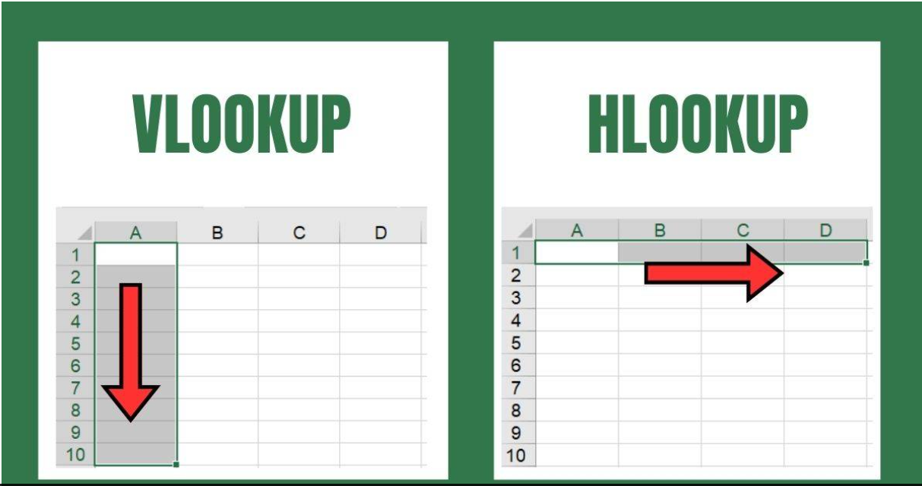

Slide 2
VLOOKUP (Vertical Lookup)
VLOOKUP is a function in Excel that allows you to search for a specific value in the first column of a table or range and retrieve a value from a specified column in the same row. It's particularly useful for looking up data quickly without needing to manually search through a list.
Syntax
=VLOOKUP(lookup value, table array, col_index_num, [range lookup])
Parameters
lookup value: The value you want to find (e.g., a specific ID or name)
table array: The range of cells that contains the data (including the column with the lookup value).
col_index_num: The column number (starting from 1 for the first column) from which to retrieve the value.
range lookup: Optional; specify TRUE for an approximate match or FALSE for an exact match.

Slide 3
Important notes (VLOOKUP)
1.VLOOKUP can only search from left to right; it cannot look to the left.
2.If no exact match is found and range lookup is set to FALSE, VLOOKUP will return an error (#N/A).
3.For more complex lookups or dynamic data ranges, consider using
INDEX and MATCH or the newer XLOOKUP function, which offers more flexibility.

Slide 4
HLOOKUP (Horizontal Lookup)
HLOOKUP is an Excel function that searches for a specific value in the first row of a table or range and returns a value from a specified row in the same column. It’s useful for looking up data arranged horizontally.
Syntax:
=HLOOKUP(lookup value, table array, row_index_num, [range lookup])
Parameters
lookup value: The value you want to find (e.g., a specific ID or name).
table array: The range of cells that contains the data (including the row with the lookup value).
row_index_num: The row number (starting from 1 for the first row) from which to retrieve the value.
range lookup: Optional; specify TRUE for an approximate match or FALSE for an exact match.

Slide 5
Important notes (HLOOKUP)
1.HLOOKUP can only search from top to bottom; it cannot look up values below
the first row.
2.If no exact match is found and range_lookup is set to FALSE, HLOOKUP will
return an error (#N/A).
3.For more complex lookups, consider using
INDEX and MATCH or the newer XLOOKUP function for greater flexibility.

Slide 6
THANK YOU
anjushaji6@gmail.com
2

